Slide 1
Easy accessibility plan for Glasgow Science Centre
TEAM 10

Slide 2
Content
Challenge Statement
Key Areas
Our idea
Back-end & front-end design plans
UX & UI goals
Complications
Demo
Additional features

Slide 3

The Challenge Statement
Can you create a mobile or web app (a digital product) that would make the Glasgow Science Centre (GSC) experience more accessible to those with any disability?

Slide 4

Key Areas
Bringing the same, or as close as possible of an, experience to those who have a disability to those who are fully able.
Having a way to easily see what exhibits are accessible or not and being able to plan accordingly.
Highlighting the science behind each exhibit, so people know more about the exhibits they are interacting with.

Slide 5
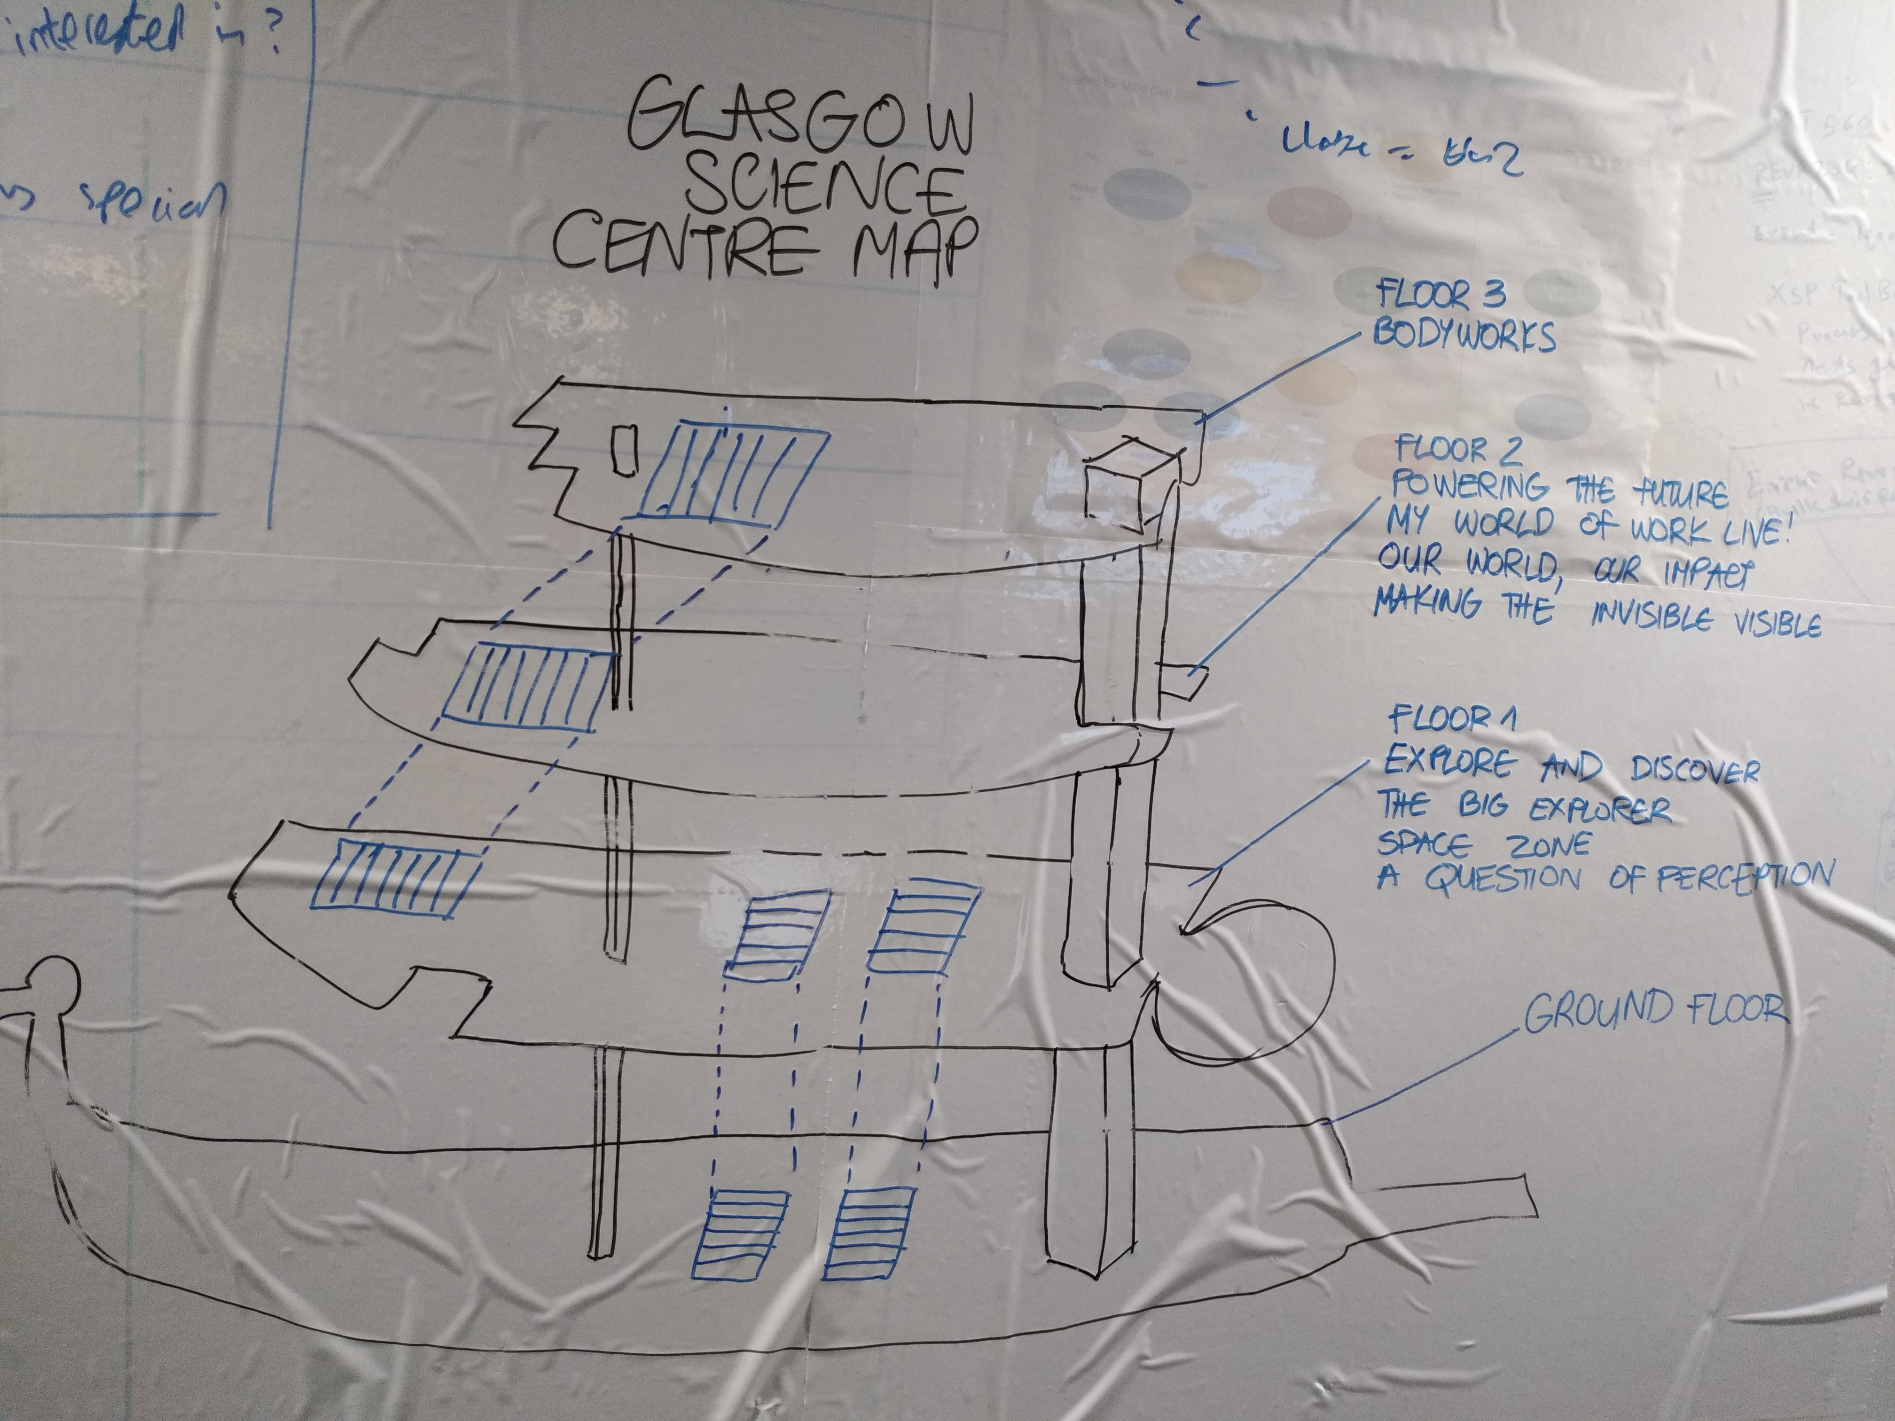
What did we decide to create?
A tool to guide visitors around the GSC
Interactive map
Ability to see instantly what kind (audio, visual, physical, etc.) of exhibits are available
Further exhibit information provided once it is clicked on
A routing algorithm showing the best way to get around

Slide 6
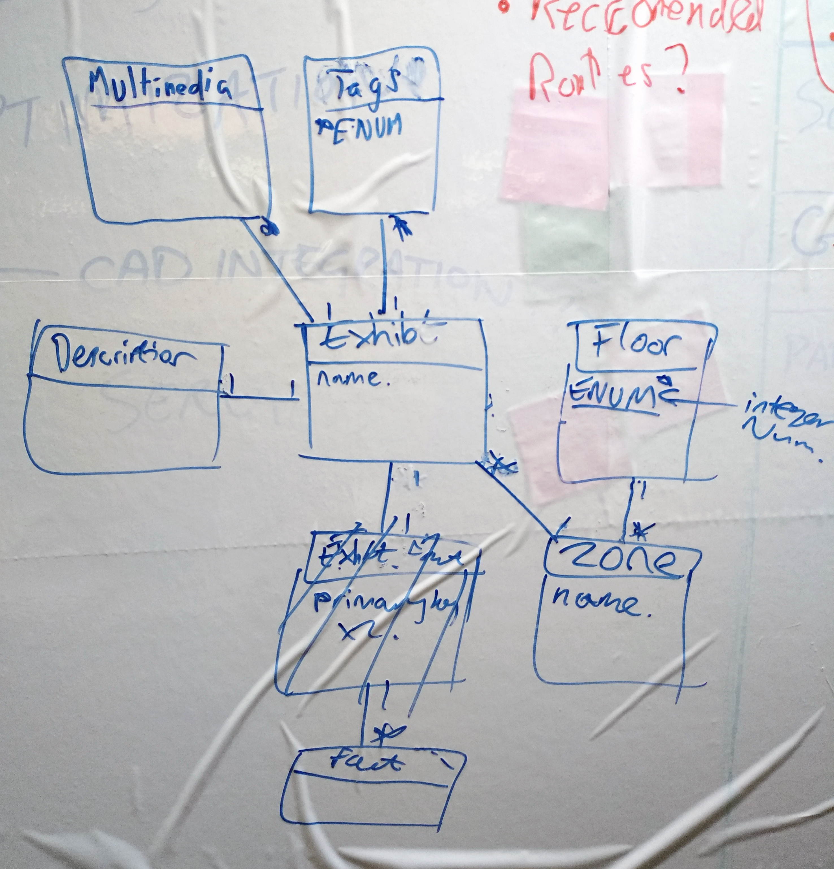
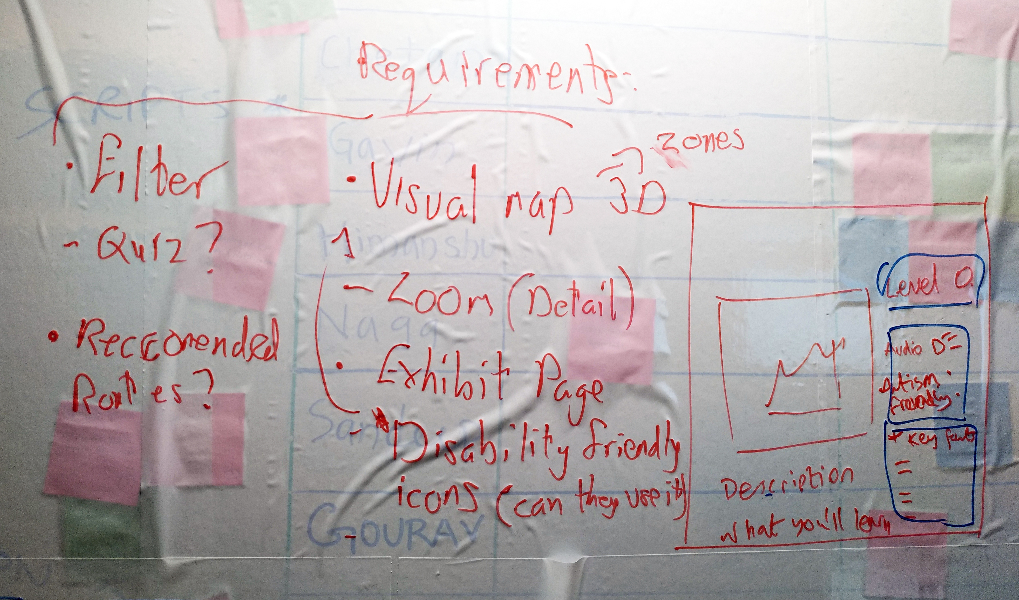
Back-end design plan

Slide 7
Original Stack choice
Discussed each member’s strengths
Ruby on Rails
Bootstrap and plain HTML/JavaScript (jQuery)
MySQL database

Slide 8
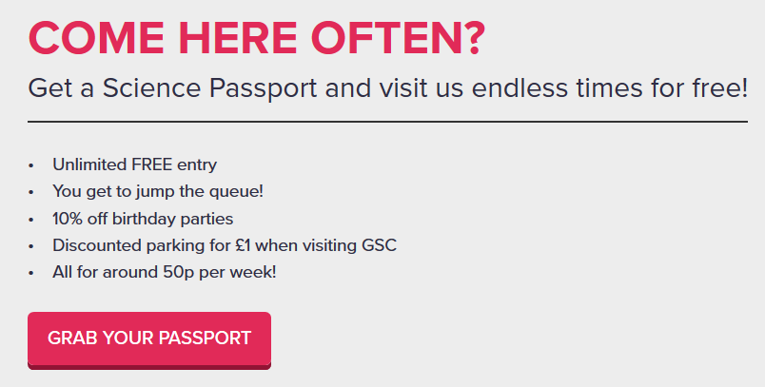
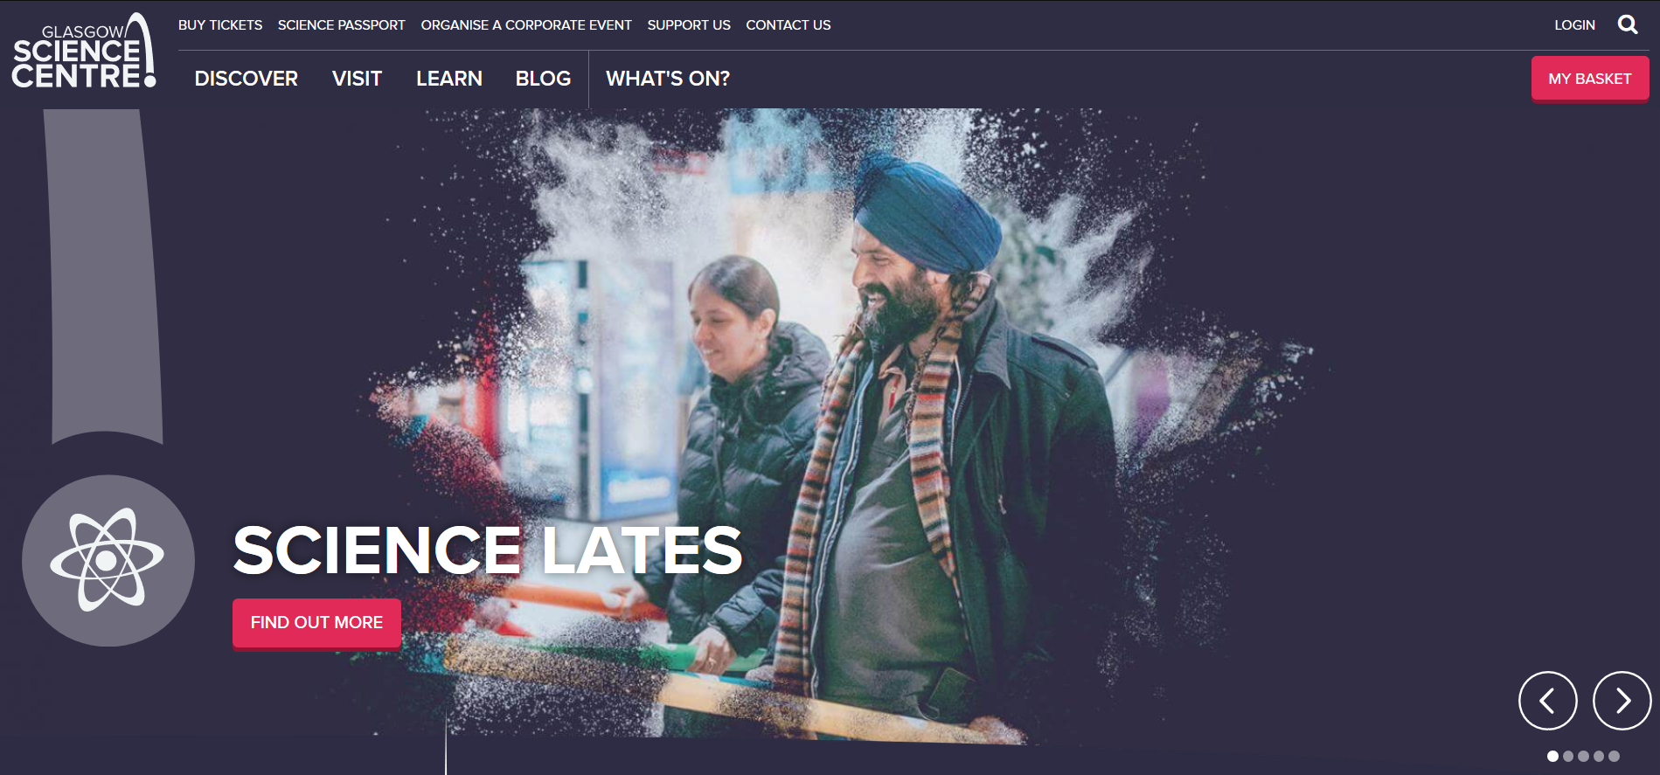
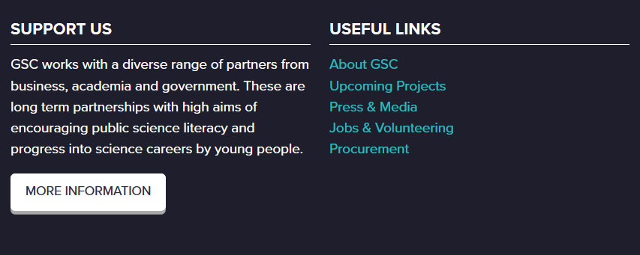
UI design decisions

Slide 9
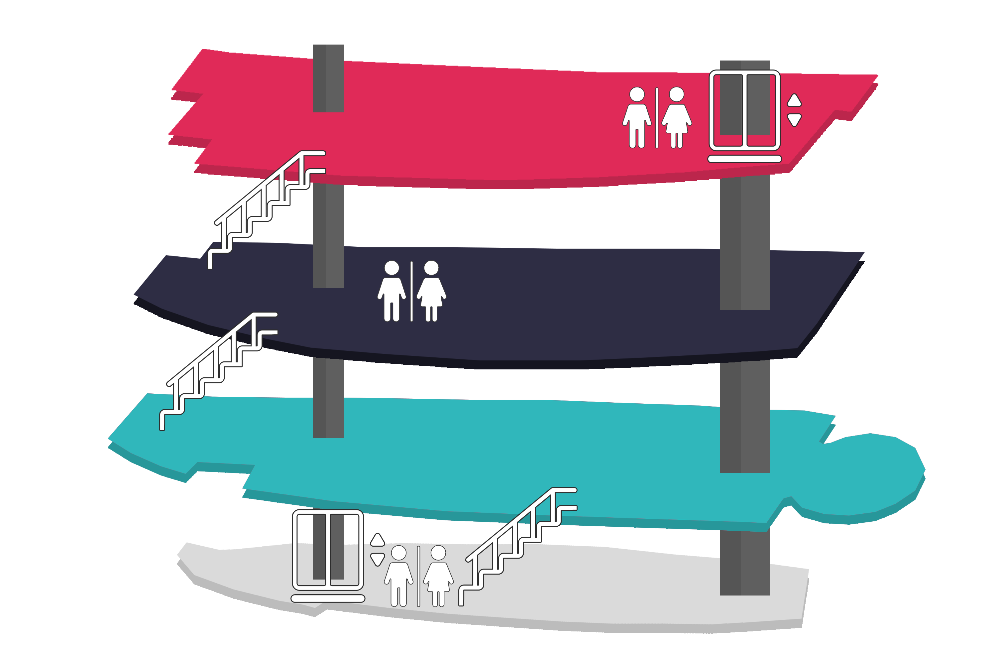


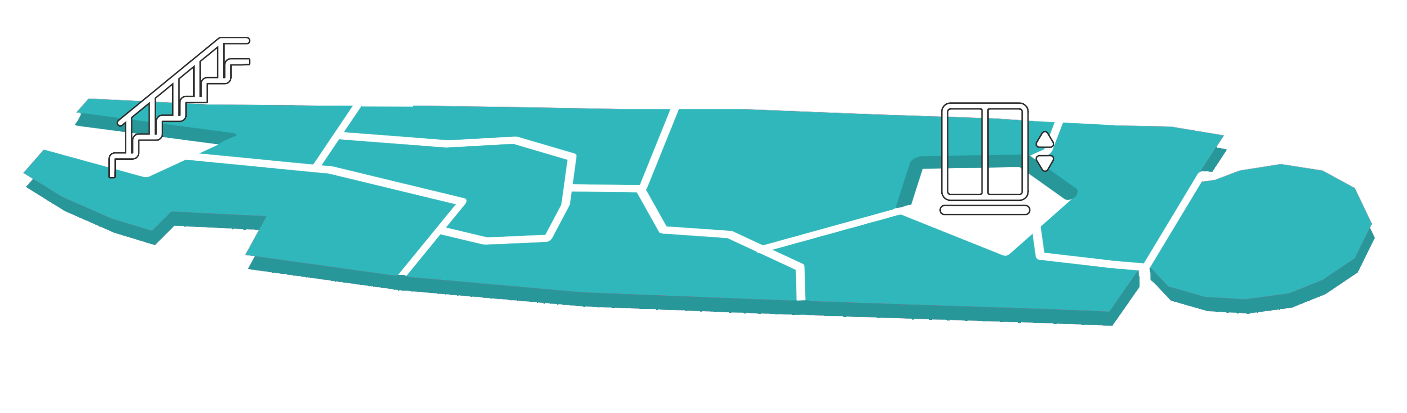
UI design decisions

Slide 10
UX and usability goals
Engaging
Exciting
Pleasurable
Satisfying
Easy to learn
Efficient
Consistent
Match between the system and the real world

Slide 11
Complications
Unfamiliarity with technology
Difficulty creating image maps
Research suggested to switch to React
Lack of time

Slide 12
Demo

Slide 13
If we had more time…
Automatic optimal route planning
More detailed, zoomable map, 3D models
Full tag implementation
Preference/interests quiz

Slide 14

Questions?

